Slide 1
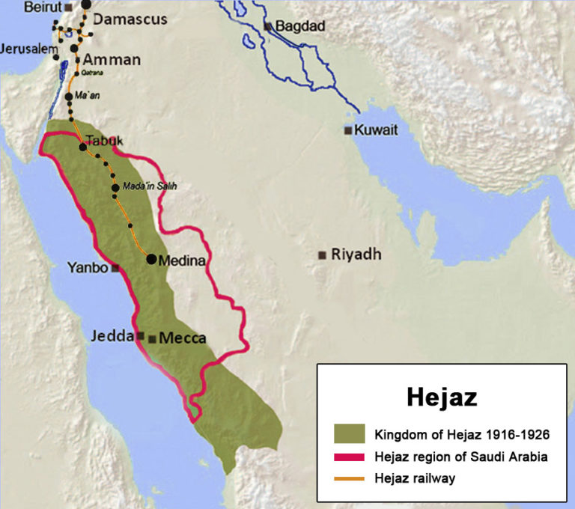
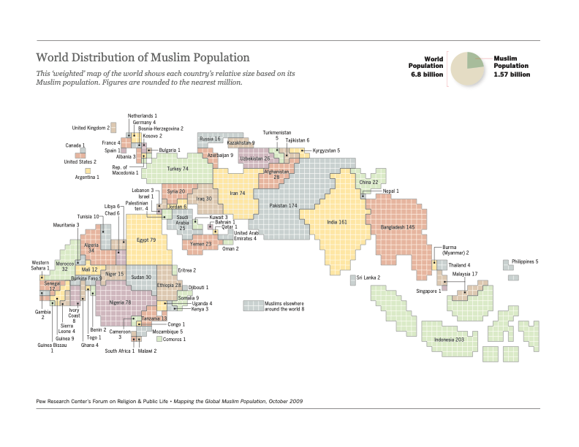
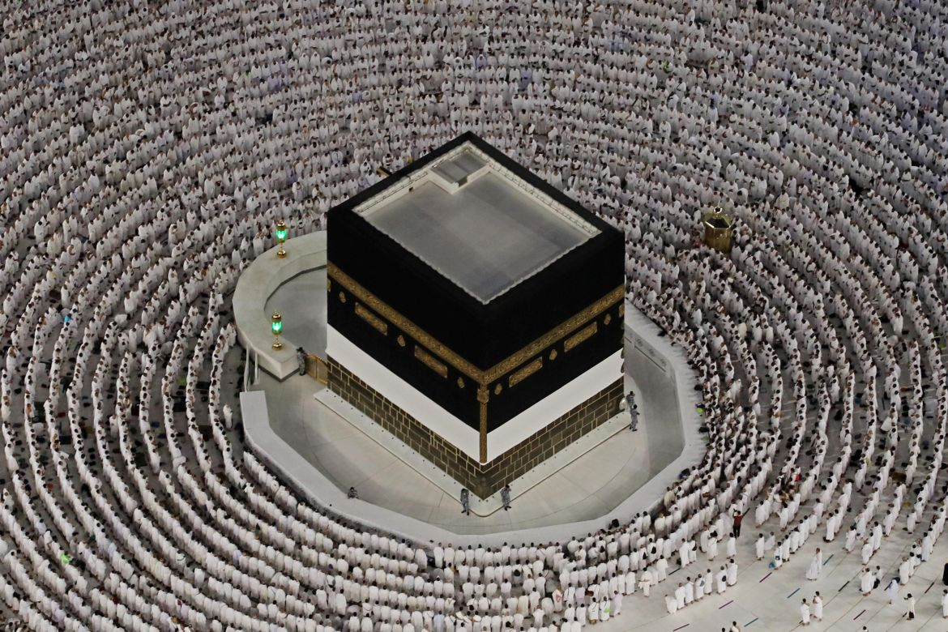
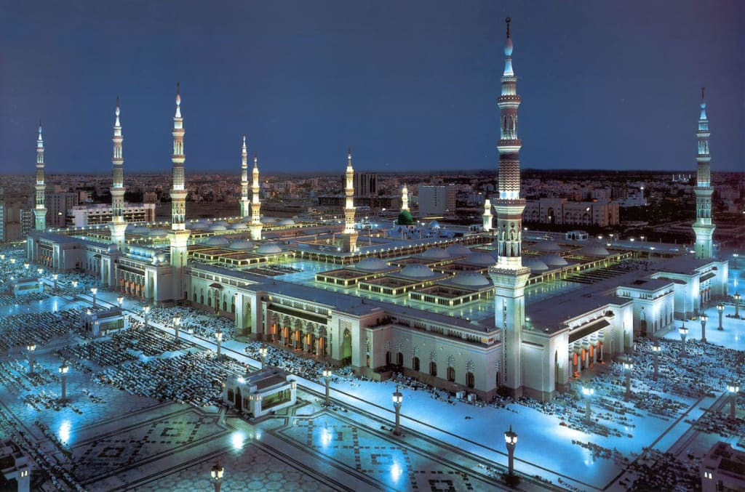
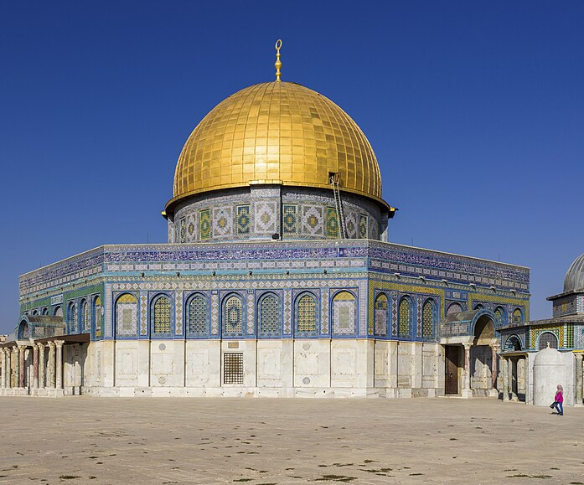
Geography of Modern Islam
Kelsey McArthur & Paula Arango Mercado
Department of Environment, Culture & Society, Thompson Rivers University
GEOG 4990_03: ST: Geographies of Religion
Dr. Humayun Kabir
Introduction
Spatial Dimensions and Religious Hearths
Islam is the fastest-growing religion in the world and is projected to overtake Christianity as the largest world religion within the century. This poster explores the spread and projections of the global Islamic population (2009- 2060) by examining:
Global distribution: Comparing birth, death, and immigration trend of Christian and Muslim populations
Spatial dimensions and Religious Hearths: Sunni and Shai Islam
Sacred spaces: Universal and local sacred spaces, traditions, and maintenance
A religion hearth is the geographical area where religion is born and initially spreads from. Secondary hearths form when the religion divides into different denominations or traditions (Stump, 2008).
The main religious hearths in Islam are in the Hejaz containing Mecca and Medina (Stump, 2008). All Muslims recognize these hearths and Shia Muslims recognize Kufa as a hearth as it is where Ali in 656 (est.) moved and grew the Shia community (Jafri, 2011). Kufa would be considered a secondary hearth as this is an area that traditions became more distinctly divided between Sunni and Shia Islam.
Methodology
Our methodology included the use of various literature reviews, maps, images, and relevant data from websites to illustrate our key points. We looked at population trends data from the Pew Research Center, the UN Demographic Yearbook, the IOM Global Migration Report and other academic articles and cultural studies. Charts were used to visually represent the global distribution of Islam and its projected growth, providing a clear and engaging overview of our findings.
Photo Credit: Seaman (2018)
Islam is divided into Sunni and Shia after the death of the Prophet Muhammad. One group, the Sunnis, believed that a member of Muhammad's tribe, Abu Bakr, should be the rightful successor to Muhammad whereas the Shias believe that Muhammad chose his successor, cousin and brother-in-law Ali (Stump, 2008). Approximately 87%- 90% of all Muslims are Sunni and 10%-13% are Shia (Pew, 2009). Roughly 68%- 80% of all Shia Muslims reside in Iran, Pakistan, India and Iraq
Results
Global Distribution of Islam
In 2015, Pew Research Center predicted that Islam, the second largest world religion, would increase from 23% of the global religious population to 30% between the years
Sacred Spaces in Islam
Sacred places in Islam are present on both universal and local scales, both possessing spiritual and communal meaning.
Global Islamic Holy Sites
Kaaba, located in the Masjid al-Haram, in Mecca is the focal point for the Hajj pilgrimage (Dakake, 2020). The Kaaba maintains purity through rituals, such as its annual purification with ZamZam water and rose water, performed by religious authorities (SaudiPedia, 2024).
Al-Masjid an-Nabawi in Medina houses the tomb of Prophet Muhammad, it is also a site of religious pilgrimage (Zeidan, 2023).
Al-Aqsa Mosque in Jerusalem, holds historical significance as it is related to the Night journey of the prophet Muhamad (Zeidan, 2023).
Local places of worship
Mosques, shines and tombs of significant figures, vary geographically and adhere to mixed traditions.
Mosques are simple places of worship, providing space for daily prayers, Friday sermons (khutbah) or congregational prayer, and public events (Raza, 2025).
Shrines and tombs of saints and scholars, particularly in Sufi orders, are pilgrimaged for spiritual reflection and healing (Levina, 2002). The local mosques rely on voluntary labor and charitable donations (Zakat) for maintenance so that they may continue to be places worship (Adair, 2018).
Photo Credit: Pew (2009)
2010 and 2050; Christianity, the current largest religion, is predicted to remain at the 2010 estimate of 31.4%. These predictions are based off global population projections, birth rates, death rates (Table 1), and immigration trends (Table 2 and 3).
Region | Dominant Religion | Population 2010 | Population 2023 | Population Increase (2010 - 2023) | Crude Birth Rates 2023 | Crude Death Rates 2023
Europe | Christianity | 738.1 | 745.6 | 1.02% | 9 | 11
Latin Ameria and Caribbean | Christianity | 588.9 | 658.9 | 11.89% | 14 | 7
North America | Christianity | 345.4 | 382.9 | 2.17% | 10 | 9
North Africa | Islam | 210.9 | 268.5 | 27.31% | 22 | 6
South Central Asia | Islam | 1,813.80 | 2,123.90 | 17.10% | 18 | 6
Southeast Asia | Hinduism | 675 | 690.1 | 2.24% | 15 | 7
Table 1. Regional Population Changes 2010-2023. Sources: UNDESA (2024), Pew (2022)
Pew (2009) states that Islam has the highest fertility rates (avg = 3.1) of all other religions and the global average (avg = 2.5). These trends were reflected in the findings shown in Table 1, where Christian dominated regions had lower birth rates than Muslim dominated regions. Death rates did not vary drastically between regions.
Most Common Migrant Designation | Dominant Religion | Percent Muslim (2010) | Percent Christian (2010) | Approx. Number of Immigrants in 2020 (million)
United States of America | Christianity | 78.30% | 0.90% | 25
Germany | Christianity | 5.80% | 68.70% | 15
Saudia Arabia | Islam | 4.40% | 93.00% | 13
Russian Federation | Christianity | 10.00% | 73.30% | 12
United Kingdom | Christianity | 4.40% | 71.10% | 9
United Arab Emirates | Islam | 76.90% | 12.60% | 9
France | Christianity | 7.50% | 63.00% | 8
Kaaba
Photo Credit: Aljazeera (2022)
Al-Masjid an-Nabawi
Photo Credit: Mubarak (2023)
Al-Aqsa Mosque
Photo Credit: Shiva (2013)
Table 2. Most common migrant destinations. Sources: Pew (2022), IOM (2024)
According to the IOM Global Migration Report (2024), in 2010 there were approximately 221 million international migrants worldwide, and by 2020 that number had increased to 281 million. In the years leading up to 2050 it was predicted that the Muslim population with decrease in the Asian Pacific due to immigration and North America, Europe, and Sub Saharan Africa can expect an increase in their Muslim populations (Pew, 2022)
Most Common Origin Country | Dominant Religion | Percent Muslim (2010) | Percent Christian (2010) | Approx. Number of Emigrants in 2020 (million)
India | Hinduism (79.5%) | 14.40% | 2.50% | 18
Mexico | Christianity | <0.1% | 95.10% | 11
Russian Federation | Christianity | 10.00% | 73.30% | 11
China | Unaffiliated (52.2%) | 1.80% | 5.10% | 10
Syrian Arab Republic | Islam | 92.80% | 5.20% | 9
Bangladesh | Islam | 89.80% | 0.20% | 8
Pakistan | Islam | 96.40% | 1.60% | 7
Conclusion
References
The increase and distribution of Islam is largely due to birth and immigration rates. Religious hearths play a huge role in religious geography as they are the origin of the religion. Universal sacred spaces unite Muslims worldwide, local sacred spaces are culturally diverse in their traditions (Adair, 2018).
Table 3. Most common migrant countries of origin. Sources: Pew (2022), IOM (2024)
The combination of higher birth rates and migration of Muslims to non- Muslim areas supports the growth of the overall Muslim distribution and growth of the Muslim population.

